Slide 1
Community Perceptions of
Renewable Energy
Sarah Mills, PhD

Slide 2
High overall support for Wind & Solar

Slide 3
But in MI communities with windfarms?

Slide 4
But in MI communities with windfarms?

Slide 5
Global Benefits,
Local Impacts
  Local Benefits
Local Concerns
Landowner payments
Tax payments, developer donations
Jobs
Climate / health
Noise / health
Wildlife
Visual Impacts
  Short and long-term
“Not why I moved here”

Slide 6
On wind, more see negatives than positives

Slide 7
What determines local attitudes about wind?
Type of land owned
  secondary vs. primary residence
  farmland / rental property
Direct compensation
  Some better than none
  $1,000 per year as key threshold
Attitudes about process
NOT environment/ climate attitudes

Slide 8
Bottom Line
Wind Energy =
Rural Economic Development Opportunity

Slide 9
Community Compensation
LBNL found stated preference for “community payment” among those not receiving direct compensation
  Examples: open space, schools, buildings, or wildlife enhancement
What is meant by Community Payment?
  Direct donations?
  Community benefits agreements?
  Property tax payments?
Notes:
Recall that LNBL’s study found people generally say they’d prefer “community payment”—defined that as open space, schools, buildings, or wildlife enhancement. There are other studies, too, that have found that that’s what people say they prefer. From LBNL question was vague on the mechanism—direct donation or through a community benefits agreement (as is common in parts of Europe). Also unclear if respondents considered the property taxes that are paid in most states as “community payments”
In reality, in most states, there is community-level compensation being made—in the form of property tax payments to local governments—but my evidence suggests that people just don’t see it.

Slide 10
Wind Property Tax Payments in Michigan
~ $20,000 per turbine
  Depreciates to 30% by Year 10
~$20M per year, statewide
Supports: Township, county, school
Notes:
In Michigan, wind developers pay, on average, about $22,000 / turbine to local governments. This amounts to an estimated $20M per year, statewide. With revenues really staying at the local level being split roughtly equally between counties, townships, school districts—though there are small shares that go to other local taxing authorities—fire districts, libraries, etc.

Slide 11
Do people recognize tax benefits?
Notes:
I asked respondents how these services had changed over since the windfarm had been build, and largely, most said there was no change. Those that did see a change were much more likely to say that services had improved rather than worsened, but even so, it was fewer than a third that said that.

Slide 12
Benefits only recognized when directly linked
Notes:
What’s going on? Well, you can tell better if you look at individual townships. Here, this is just showing the impact that people felt the windfarm had on township services and there’s a clear outlier. This is not the township with the most turbines or the most impoverished township where those tax monies would really go far. No, it’s the township that introduced trash collection. In the other townships, the tax monies were being put toward improving roads—paving an extra mile or gravelling a couple extra miles a year. But it was only visible to those when there was a specific service.

Slide 13
Why Community Benefits Are Important For Wind
Few direct local long-term jobs; opportunity to “see” impacts
Give everyone stake; approximate Europe/MN “community ownership”
Most wind projects = net exporter of energy
But… Impact on ratepayers (esp. low-income)

Slide 14
Community Benefits
For Solar?
Local (negative) impact more limited
  Minimal noise
  Easier to screen
Even so, seeing objections
  Wise use of farmland
  Run-off
  “Not why I moved here”
Fewer landowners directly benefit (lease payments)

Slide 15
The CLOSUP Wind Project
Sarah Mills, Project Manager
Phone: (734) 615-5315
Email: sbmills@umich.edu
Web: www.closup.umich.edu/wind

Slide 16

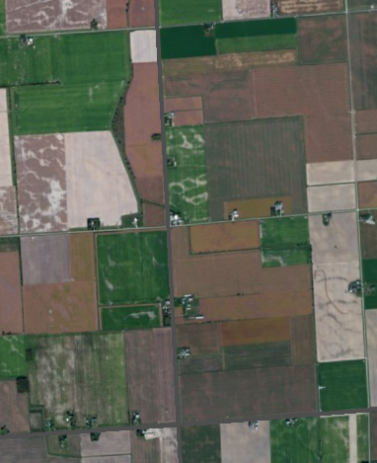
Direct Benefits to Others
Old Model: Winner takes all
  Disturbance
  Royalty
Newer Model: Pooled Royalties
  Usually per-acre
Newest Model: Includes Smaller Parcels
Direct benefit to others depends on model

Slide 17
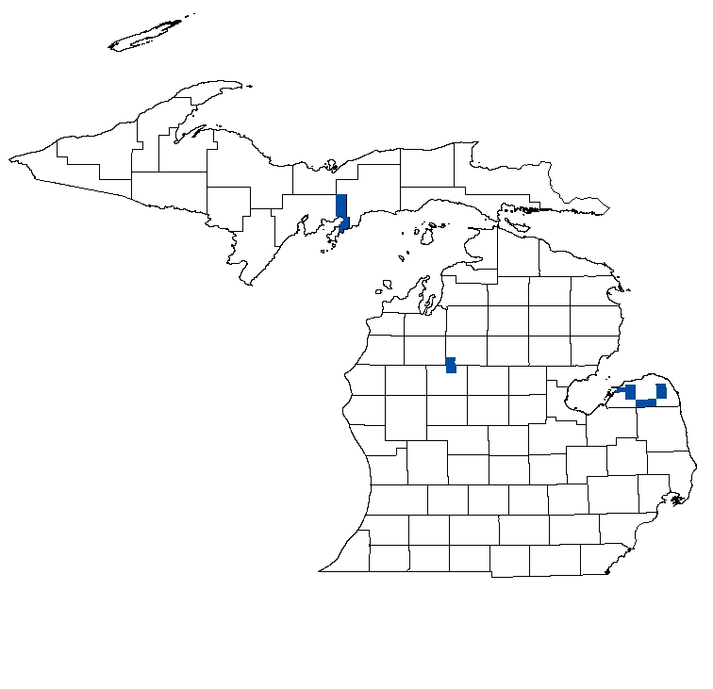
2016 Community Survey
Owners of land assessed ag or residential
10 townships with windfarms
2,013 responses
(53% response rate)
Funded by C.S. Mott Foundation
Notes:
Huron County: Bingham, Bloomfield, Chandler, McKinley, Oliver Sheridan, Sigel
Missaukee/Osceola Counties: Highland, Richland
Delta County (UP): Garden

Slide 18
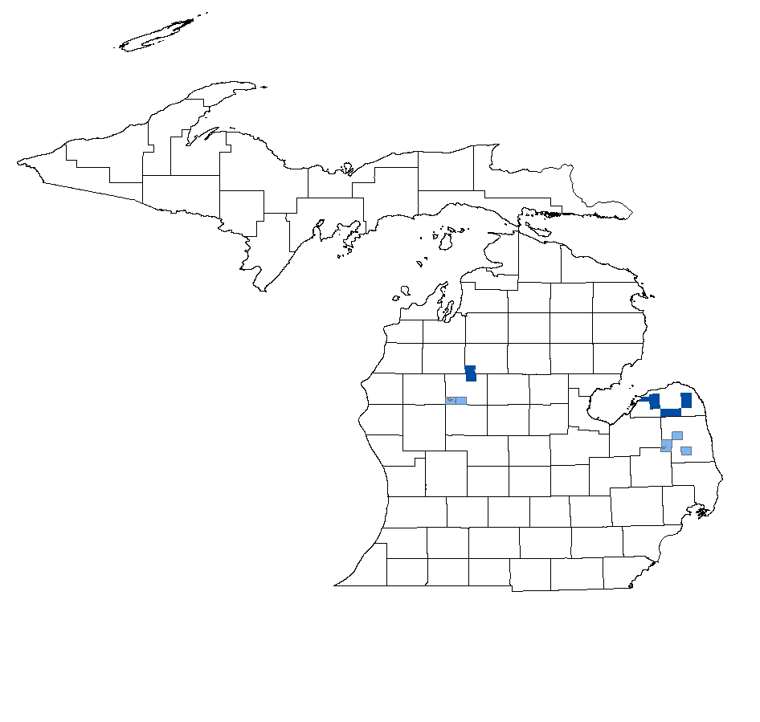
2014 Farmland Survey
All owners of land assessed ag
14 townships
  9 with windfarms
  5 without
1,210 responses
(72% response rate)
Funded by Dow Fellowship

Slide 19
Does Pooling Royalties change Community Attitudes?
Pooling doesn’t decrease support of those with turbines
Pooling does change narrative
  Traditional model
    More comments about tension
    “Greed” of few getting paid
  Pooled model
    “Jealousy” of few not getting paid
Citation: Mills, S. (2018). Wind Energy and Rural Community Sustainability. Handbook of Sustainability and Social Science Research. Edited by Leal Filho, W., Callewaert, J. & Marans, R. Zug, Switzerland: Springer.
Notes:
One of the things I have also looked at is if pooling decreases how positive those with turbines are about the wind energy. Does getting a smaller check decrease their support compared to those in windfarms with the traditional royalty model. Running a regression to control for pooling and looking for interactive effects, I’ve found that it doesn’t—so you aren’t shooting yourself in the foot by pooling. And, in fact, I have some evidence that it does change the narrative about the project. Looking at open-ended comments on my survey, I’ve found that those in a community where the traditional model is practiced are more likely to talk about the windfarm causing tension, and there were more comments about the “greed” of the few who were getting paid, bringing this on the community. In the community where pooled royalties model is used, fewer comments about tension, and the tone is different—people were more likely to comment on the “jealousy” of those few who were not getting paid.

