Slide 1
Glen Lake Schools Solar Project
Sonja Stairs
Carson Reay
Stella Young
Emma Spencer
LuAnne Dreves
Advisor - Karen Richard

Slide 2
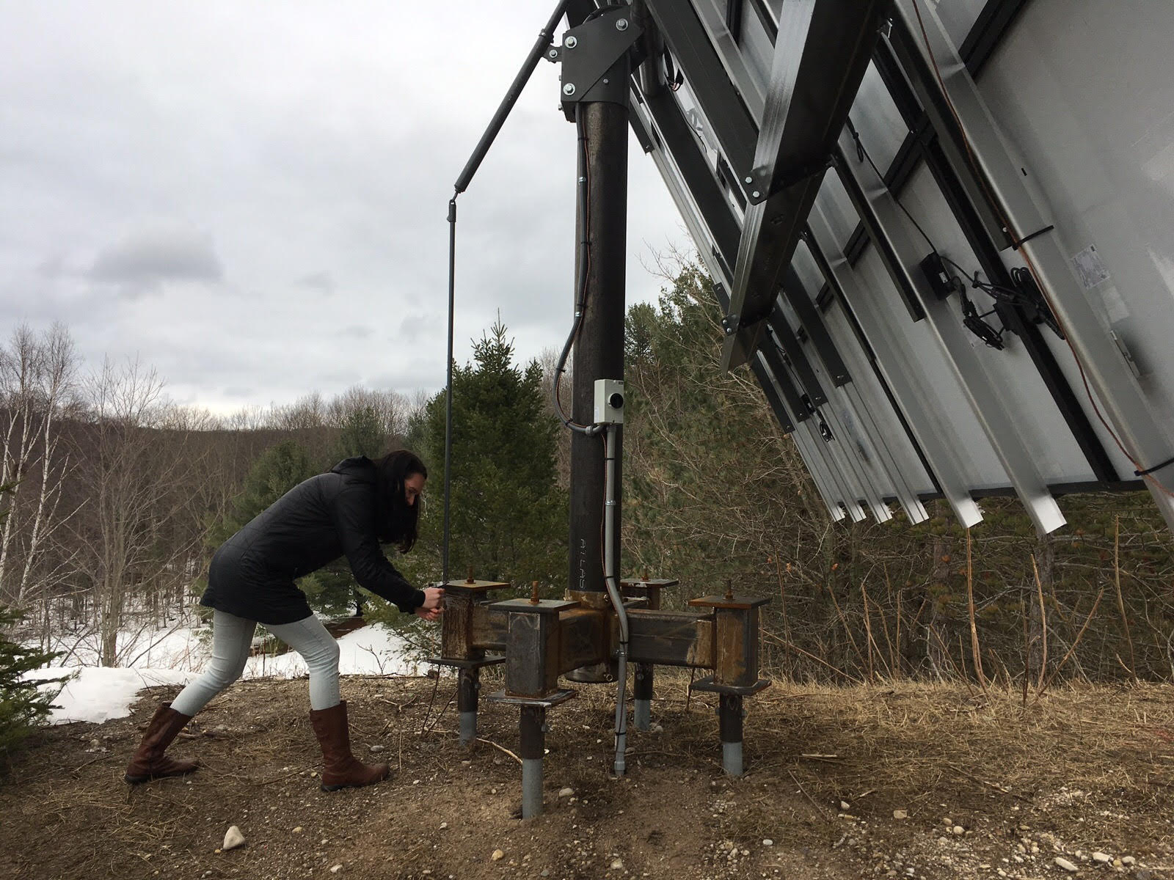
Background: Why is this project important?
Educational resource
Students can use data from the system as they study energy in physical science, physics, and math classes.
Problem solving skills can be developed and used as students continually investigate how to improve and increase the system.
Students can gain information about how renewable energy can be used and developed.
Students can learn about changes in the amount of insolation our area of the earth absorbs throughout the year and can learn the optimal angle to tilt the panels to absorb light.
Students can be actively involved in changing/adjusting the tilt of the panels as the angle of the sun’s rays change throughout the years. Students can also learn about how the angle of the sun’s rays change through the changing seasons.
Students can gain a sense of environmental stewardship while taking care of the solar panel and understanding how it benefits the planet!

Slide 3
Why is this project important?
Environmental Benefits
A solar system would provide a sustainable source of energy that does not emit greenhouse gases
Solar systems would reduce air pollutants like particulate matter, SO2, and nitrogen oxides, which are toxic gases that can form acid rain and/or photochemical smog. The acid rain can damage the environment and these air pollutants can cause health problems such as respiratory diseases.
Having solar as an energy source would shrink Glen Lake’s carbon footprint
Less reliance on fossil fuels
Solar energy won’t run out
Reduces CO2 emissions which leads to sea levels rising(melting ice caps), less fresh water, habitat loss, and increased extreme weather

Slide 4
Project Description: what is your project idea?
Our large scale dream would be to power our entire school with solar power. But after doing some preliminary research we realized that would be not feasible for us at this time.
Now we are focusing on installing one 24 panel array.
This panel will be more for educational purposes instead of a high energy producing system. Our team hopes to promote environmental stewardship by encouraging students to participate in adjusting the tilt of the panels and analyzing data gathered from the panels..

Slide 5
Solar Energy analysis: how much energy and savings will your system produce?
Our group is focusing on a fixed ground solar array composed of panels that are 290 watt per paned. A single 290 watt panel on a fixed ground array will produce 1.1x290 = 319 to 1.2x290 = 348 kWh per year.
At this time out group is starting on a small scale due to budget constraints. If an array of 24 panels are installed about .8% of the school’s energy requirements would be met (24 x 290 x 1.2 = 8,350 kWh/year. The school uses 87,000 x 12 = 1,044,000 kWh/year).
We realize this is not much, but it does offset a small amount and it is a start. If we were to install a solar system that would provide enough electricity to meet all electrical needs at school it would take 125 24-panel arrays to meet these needs.
The school pays 8.6 cents per kWh. 24 panels of about 290 watt will produce $823.54 in solar energy. This is not a very great financial return for our school and would cause the array to pay for itself in about 25 years (schools don’t get and tax/grant financial incentives- so the payoff is much less than a residential system where the home owners can get some of these incentives). We aren’t too concerned with this slow payback time since the main purpose of our system will be educational at this time

Slide 6
Project Plan: How do we make this project happen?
Financing will be sought from local grants (Rotary Good Works Grant, $5000, Grand Traverse Foundation Grant, $2000 are two grants we are pursuing and applying for) and hopefully the school will match some of what we raise.. Some of the work/labor may be done by on grounds and maintenance help and /or students.
We have already met with our principal, superintendent, and a sub-committee of the school board and told them about our plan to gather their support in installing this solar array!
We have a meeting scheduled in April with the Building and Grounds Committee to share our proposal and will present to the school board on May 14 to get final approval.
A couple challenges that we may face are funding and finding the right spot to put the array.
We are hoping to receive some funding from our school board in addition to money that we fundraise ourselves..

Slide 7
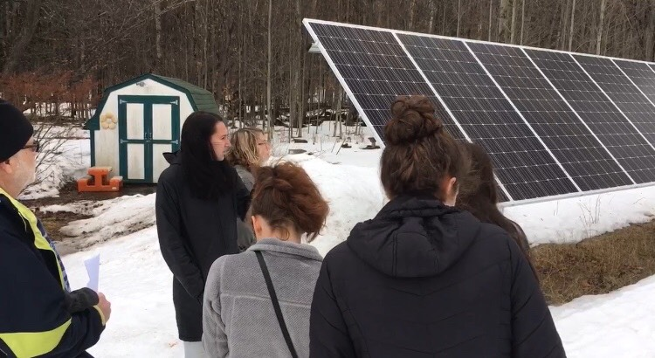
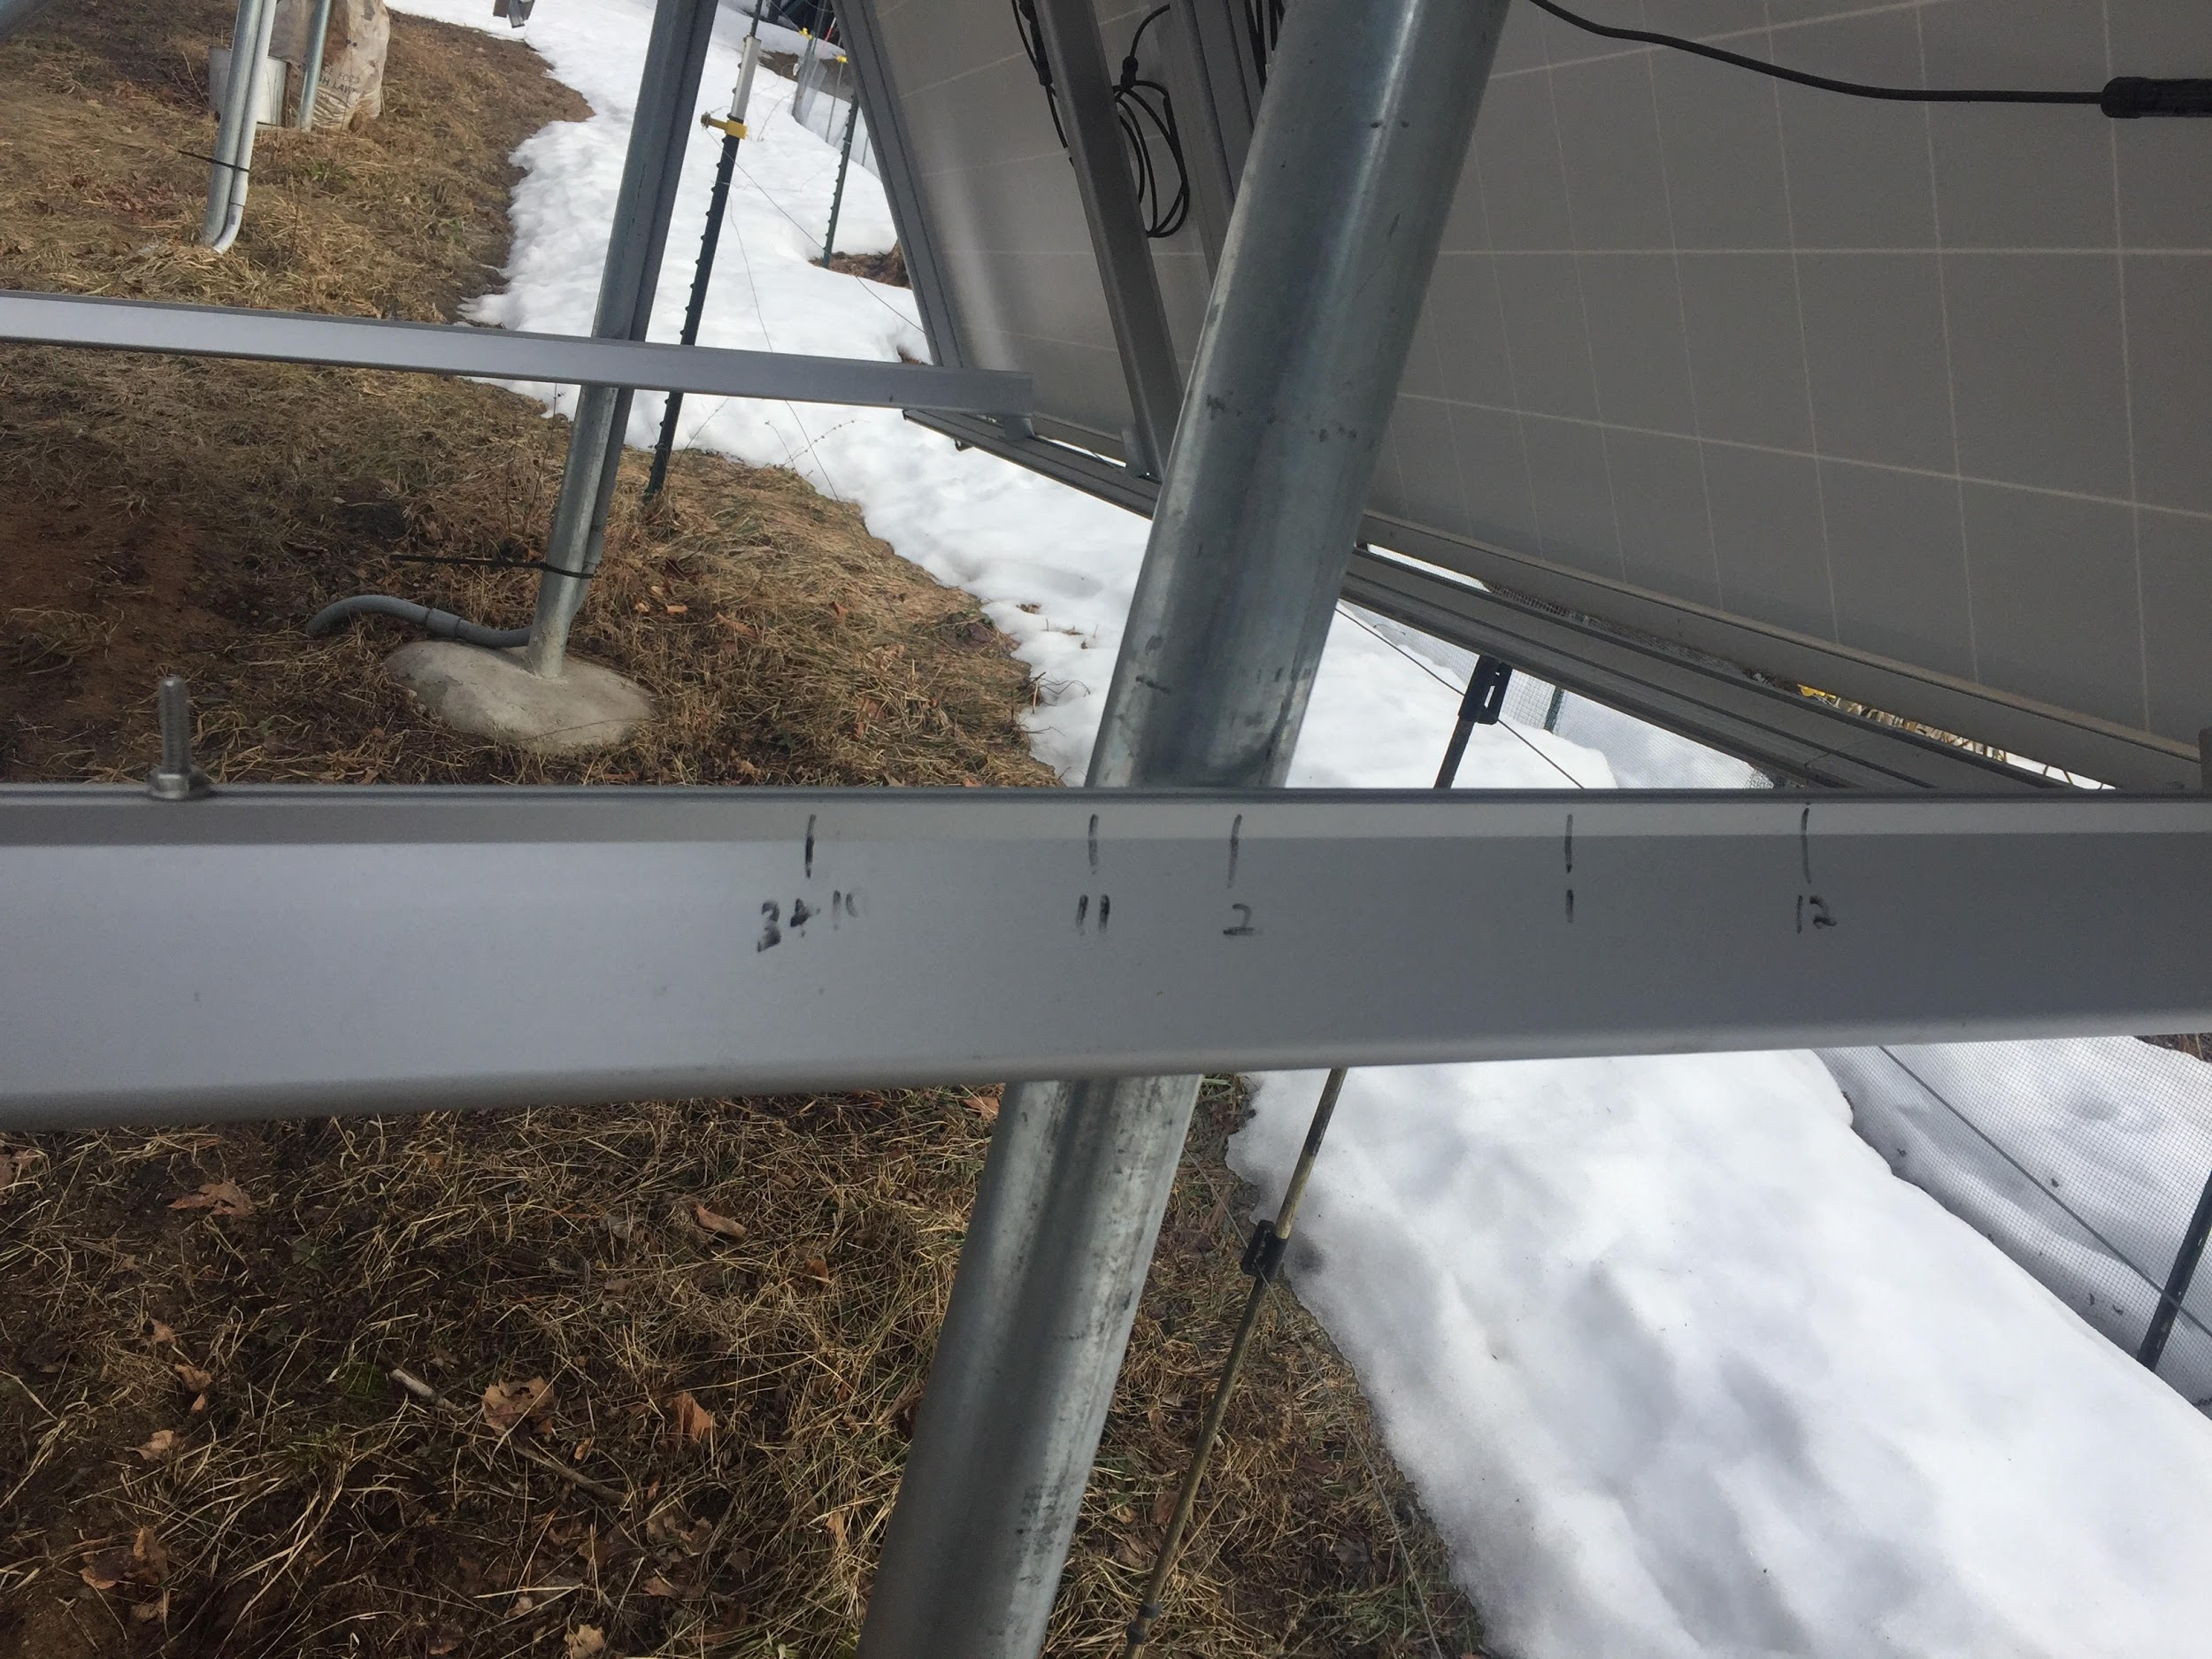
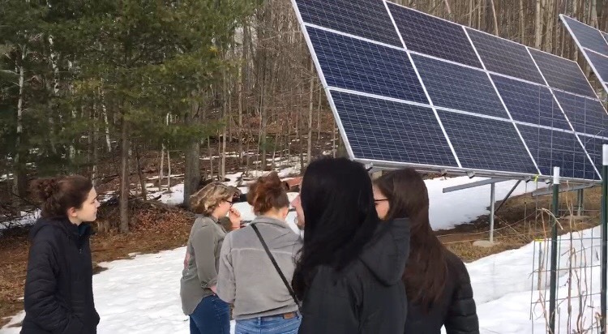
We had the chance to visit some solar arrays at the homes of local residents. This allowed us to better visualize they type of array we want at our school

Slide 8
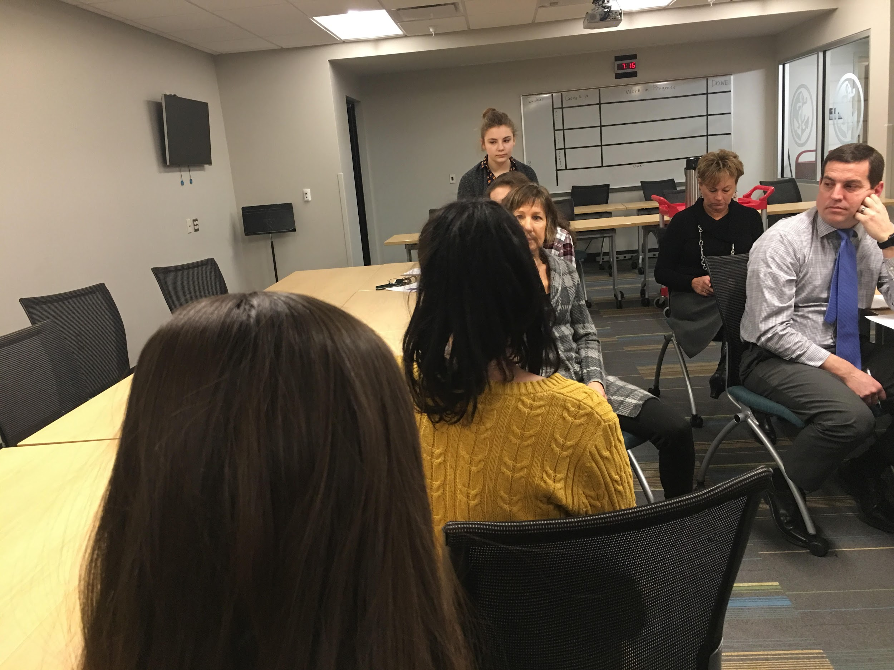
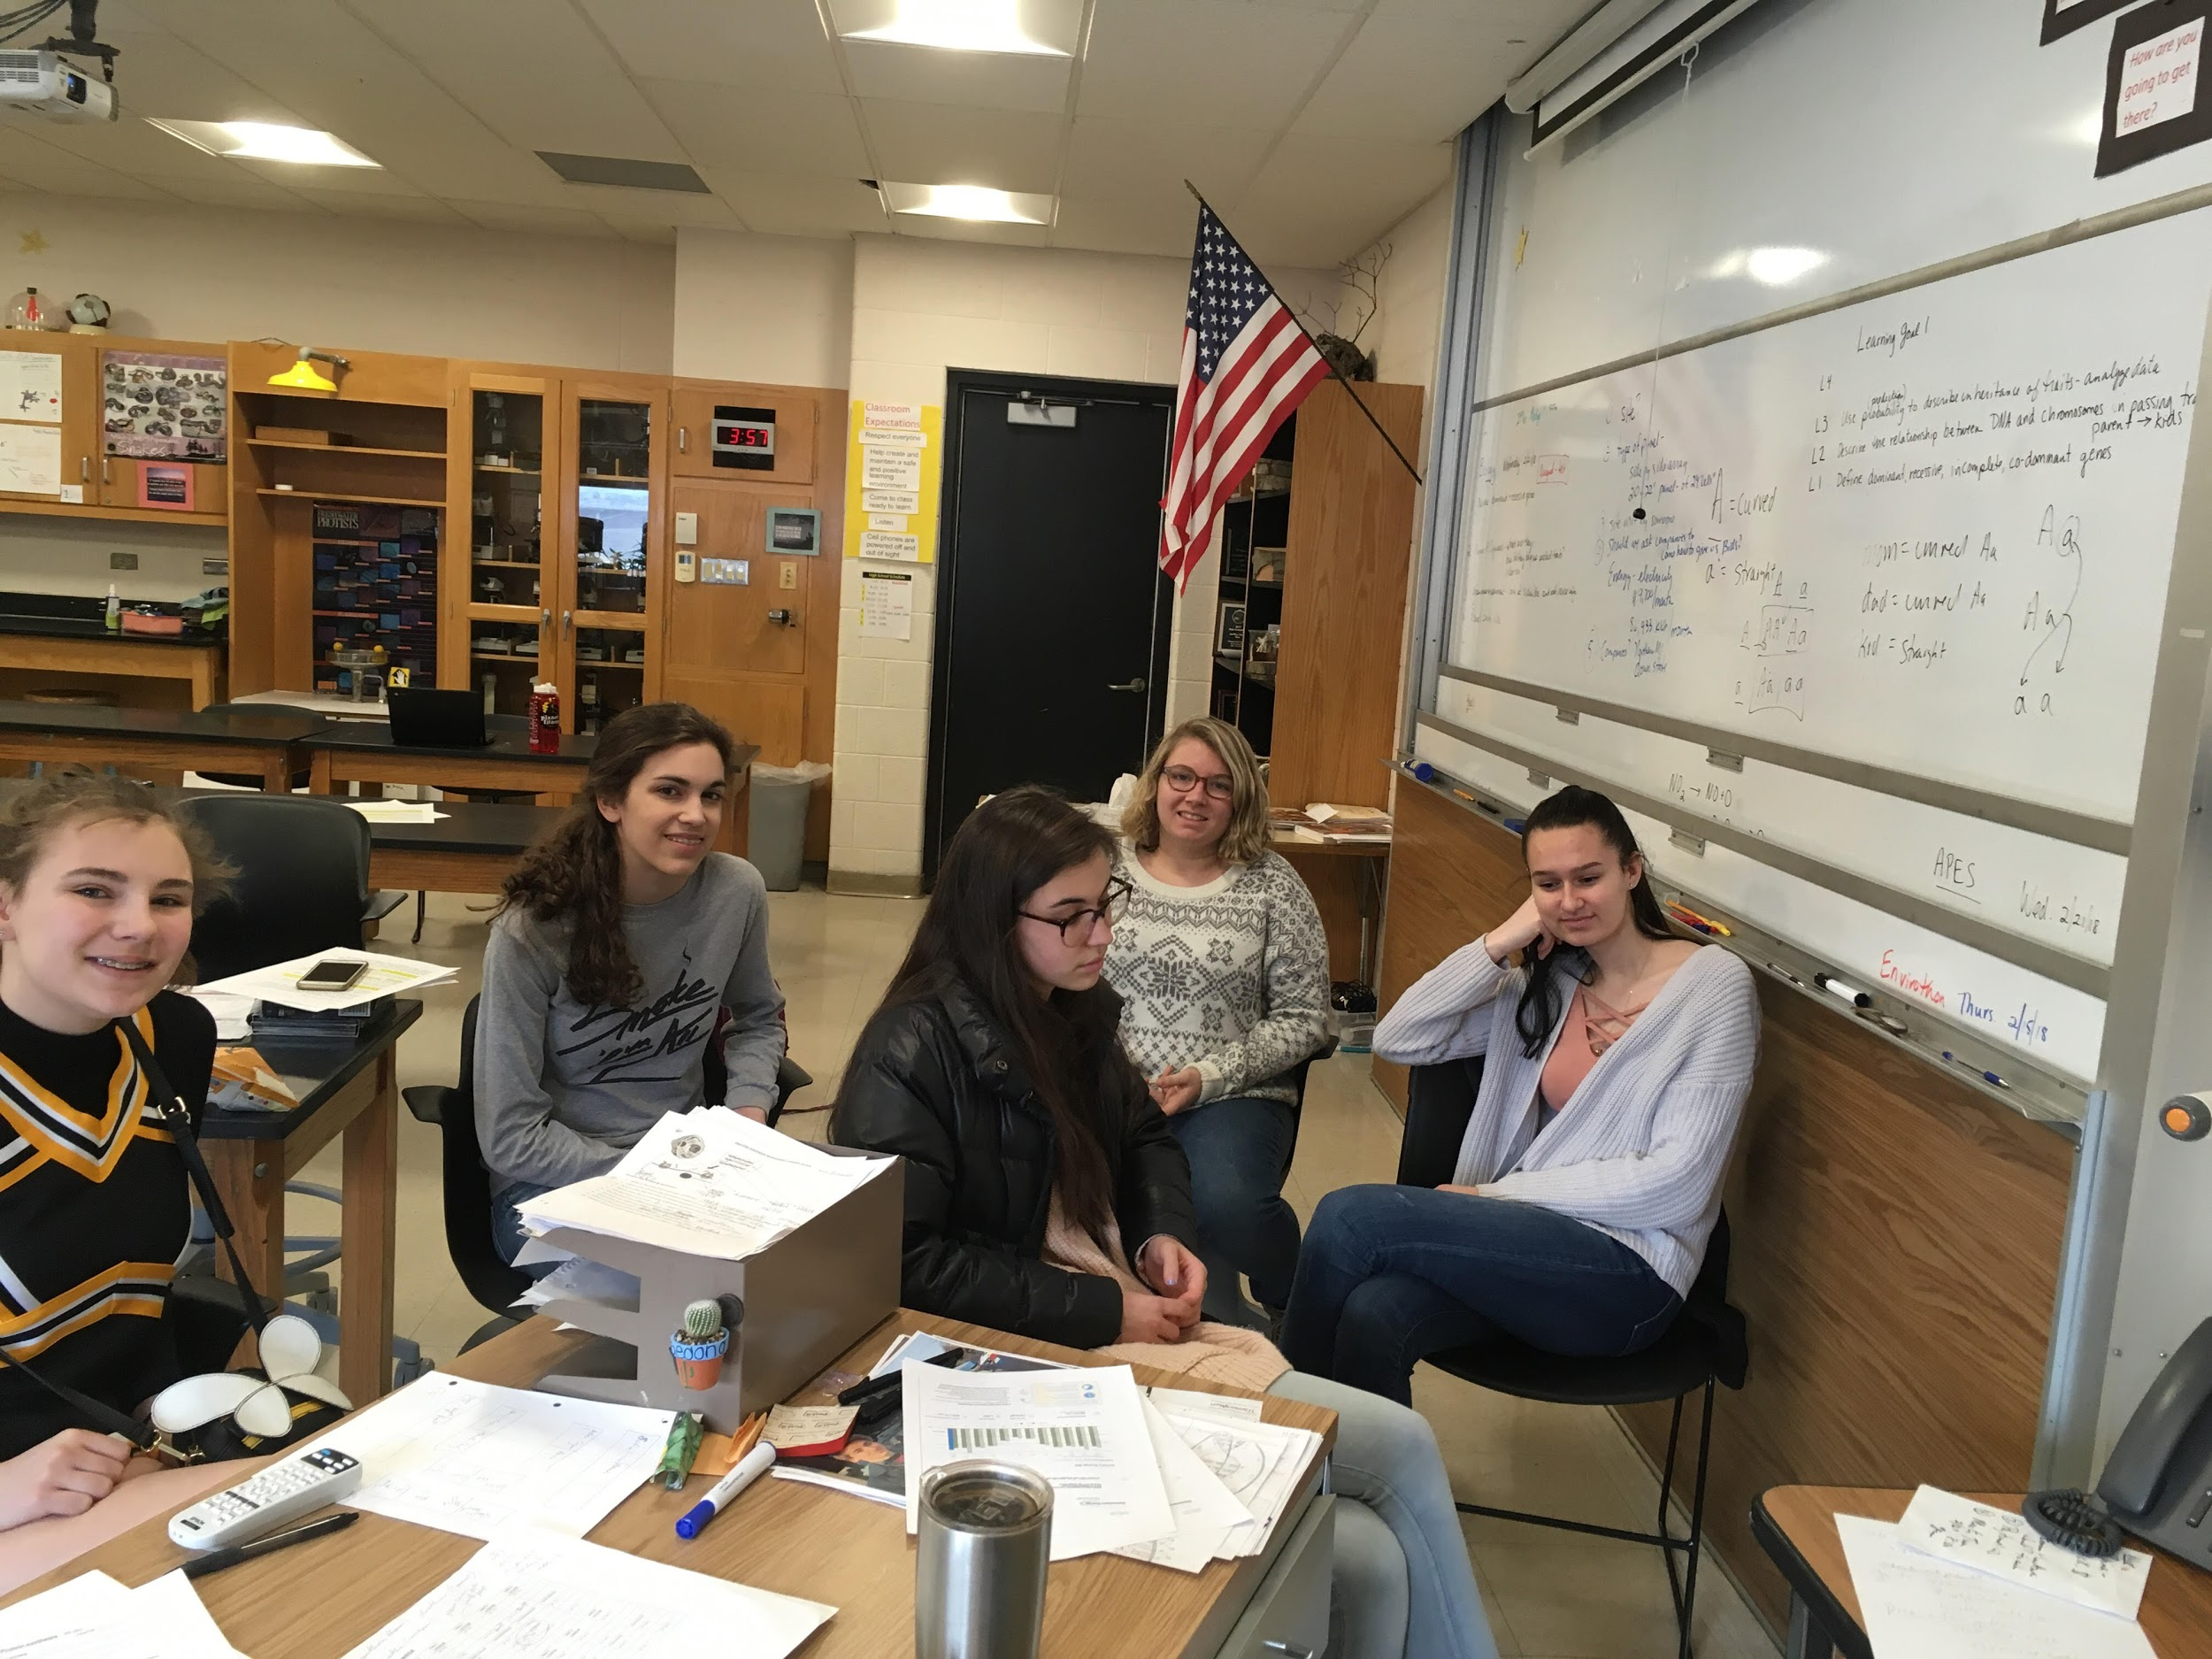
Our group has presented out findings and project idea to our principal, to our superintendent, and to the Curriculum Committee. The next steps are to present to the Building and Grounds committee (April 19) and the school board (May 14)

Slide 9
Time line
After the presentation to the school board and approval…..
Select which bid is the best one for our school and project
Have the solar company come for another visit- to plan exact location
Finish applying for grants
Apply for permits
Install the panel
Communicate to teachers how they can incorporate the solar arrays into their curriculum
WE WILL MAKE THIS A REALITY!!!!!!i

